Slide 1
Project
HR Dashboard
Description : -Analysis the data to understand the how much employees are work ,what the percentage of Active employees and analysis the gender data over the 4 years of period of time. Create multiple sheets for different sections of the dashboard, linked through a main navigation page.

Slide 2
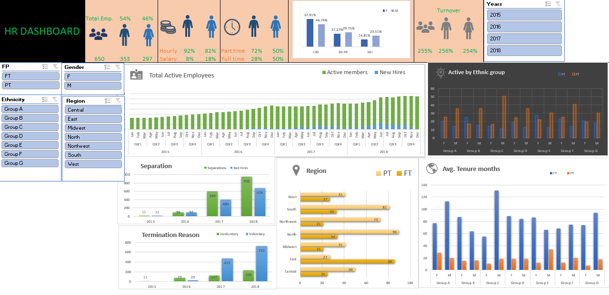
Overview:-

Slide 3
Insights 1:-Total Active Employees

Slide 4
Insights 2:-Active by Ethnic group

Slide 5
Insights 3:-Average Tenure Months

Slide 6
Insights 4:-Employees Region (work part time and full time)

Slide 7
Insights 5 :-Hiring activity over the year

Slide 8
Insights 6:-Termination Reason

Slide 9
THANK YOU

